Slide 1

On the use of existing upper ontologies as a metadata integration mechanism
Miguel-Ángel Sicilia
University of Alcalá
msicilia@uah.es

Slide 2
Outline
Motivation
Representing resources
Representing descriptions
Other common metadata concepts
Outlook

Slide 3
Semantics and metadata interoperability
Greenberg (2003): metadata is “structured data about an object that supports functions associated with the designated object. [...]”.
  The variety of functions and communities creating metadata specifications has resulted in a proliferation of schemas.
  Interoperability becomes an issue.
Metadata schema “harmonization” attempts to integrate and solve “semantic gaps” between pairs of schemas.
If the approach is formal and not simply conceptual, mapping schemas leads to a form of logical mapping of a relative complexity.

Slide 4
… upper ontology as an a priori approach
Instead of mapping schemas pairwise, a common “upper” ontology can be used to provide common semantics.
This used as an approach for the development of new schemas would result in a priori “readiness” for interoperability.
Is there any common ontology of enough quality and comprehensiveness?
  IEEE P1600.1 Standard Upper Ontology Working Group (SUO WG) seeks a standard for “specify an upper ontology to support computer applications such as data interoperability, information search and retrieval, automated inferencing, and natural language processing”.
  Ontologies considered as OpenCyc and SUMO are the results of large efforts of engineering!

Slide 5
Mapping DC to OpenCyc
OpenCyc is a good candidate:
  Builds on industrial investment and years of engineering.
  Development tools and browsers available.
  Sound models for the upper concepts
The process of mapping is as follows:
  Find one or several terms that subsume the category under consideration.
  Check carefully that the mapping is consistent with the rest of the subsumers.
  Provide the predicates appropriate.
  Edit it in Protègè or other editor.
The reification of resources as instances is assumed.
  This entails a common representation, and transformations can be used to other representation formalisms.

Slide 6
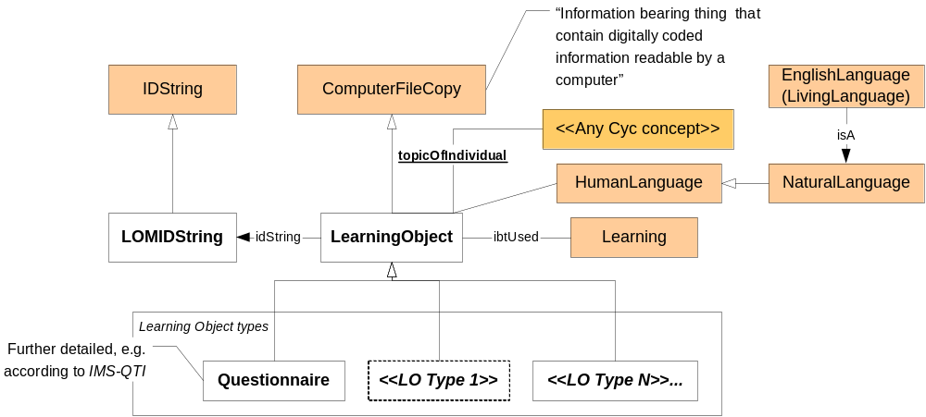
Example I: OpenCyc and learning objects

Slide 7
Example II: Ontology of the SWEBOK
The word “Specification” appears 138 times in the GUIDE.
  “Requirements specification typically refers to the production of a document, or its electronic equivalent, that can be systematically reviewed, evaluated, and approved”.
    Production of a document is a oc_Action (event with a doer), or better a oc_PurposefulAction since it is done by a oc_IntelligentAgent.
      But are the review, evaluation and approval sub-actions (oc_subEvent) of the specification itself?
    The oc_Specification itself is a oc_PropositionalConceptualWork.
      This enables a representation of the contents of the specification in logics!
    but the “document” is an oc_InformationBearingThing, related by oc_PITOfIBTFn with the propositional thing.
    And the electronic copy is no other thing that another IBT, this time also a oc_ComputerFileCopy but is this ontologically relevant?

Slide 8
Mapping DC to OpenCyc terms (i)
The DCMI Abstract Model mentions resources and descriptions as the two main elements of the standard.
  Resources are described as “anything that has identity” and represent also aggregations of resources
Alternatives:
  oc_Thing, which “contains everything there is”.
  oc_ComputerDataArtifact, defined as “The collection of all pieces of computer data stored in hardcopy form or in computer memory. This collection includes all such information, such as data streams […] and more complex objects such as files in a filesystem”.
  oc_InformationBearingThing that refer to elements with “interpretable contents”, for which metadata elements as “keywords” seem more applicable.
  The subsets of oc_Things with oc_UniformResourceLocator “a resource is anything that has identity”.

Slide 9
Mapping DC to OpenCyc terms (ii)
A property in DCMI abstract model “specific aspect, characteristic, attribute, or relation used to describe resources”.
  This in OpenCyc can be assimilated to the notion of predicate, sub-predicates can be assimilated to “sub-properties” in the DCMI.
  the semantics of these predicates are the “surrounding concepts and definitions” that are related to the given predicate.
Subsumption semantics is a flexible capability of “refined semantics” as described in DCMI abstract model.

Slide 10
Mapping DC to OpenCyc terms (iii)
DCMI Element | OpenCyc definition | Description
Coverage | oc_SpatialThing oc_TimeInterval oc_jurisdictionRegion | oc_SpatialThings and related predicates (e.g. oc_spatiallyContains) can be used to refer to spatial locations or relative relations, including oc_GeographicalThings as expressed in the TGN vocabulary. oc_TimeIntervals can be used to specify temporal periods and oc_jurisdictionRegion enables the connection of legal organizations with geographical regions.
Creator | oc_createdBy | Declates the oc_Agent responsible for making the content or information of the oc_IBT.
Format | oc_CommunicationConvention | Formats in the DCMI model are assimilated to MIME types, which are no other thing that formats of digital resources. Communication conventions are general-purpose and should be refined to include current resource types.
Language | oc_HumanLanguage | Human language subsumes both natural languages (most of them are declared as instances), and purposely created languages. A new predicate would be required since existing ones do not directly capture the semantics of the element, e.g. oc_languageOfCommunication relates languages to communicative acts but not to oc_IBTs.
Publisher | oc_publisher | The publisher predicate connects instances of oc_PublishedMaterial (a subclass of oc_IBTs) to the agent that publishes them.
Source | oc_referenceInWorkTo | The oc_referenceInWorkTo can be used to model explicit references; nonetheless, a broader concept would be required.

Slide 11
Mapping DC to OpenCyc terms (iv)
Some (even) more controversial mappings:
  Description: oc_descriptionSentences predicate can be used for formal description
    But the scope of “description” in Dublin Core is much broader, and includes any relation to other diverse resources (e.g. an abstract would be another oc_IBT).
    A general purpose “hook”?
  Relation: “describe references to related resources”. If we focus on oc_IBTs, OpenCyc provides a number of predicates, e.g. oc_hasFormat, oc_hasPartTypes/partOfIBT.
From the ABC model:
  Actuality in ABC “encompasses entities that are sensible”, in contrast to abstractions that express “concepts or ideas”.
  OpenCyc provides an oc_Intangible collection that represent things that “are not physical -- are not made of, or encoded in, matter”.

Slide 12
Outlook
The “linking to upper ont” approach avoids the problem of “harmonization” and provides rich computational semantics.
  With the added benefit of providing a rational way of discussing ontological decisions.
Some possible mappings from DC to OpenCyc have been discussed, but more formal work is required.
This does not preclude the use of metadata as is present today on the Web, but provides better opportunities for delegation to (logics-based) agents!

